Slide 1

Cat 4 Tariffs & Quota’s

Slide 2
Background
Under TWO rules current steel quotas and tariffs expire on 30th June 2026 and need to be changed
We agree with the broad objective to support the UK by promoting UK steel manufacture, whilst maintaining required imports to support the UK steel market.
We welcome Tata’s investment in Port Talbot and would like to support Tata in creating a world leading competitive and profitable steel mill. This is what the UK requires and is in the national interest.
Currently the UK imports a substantial proportion of Category 4 products from numerous countries depending on application and price these imports are essential to sustain the UK steel market, which employs ten of thousands of people. The downstream steel market is very complex which relies on these imports.
We agree broadly that the current quota level of circa 1.9m tonnes is too high, based on current market demand of circa 1.4m tonnes, but any reduction should be carried out in a controlled manner due to steel market complexity.
Tata as a steel mill has a higher cost of manufacture making it not as competitive as some foreign mills especially for certain commodity grade products. As well as supporting Tata through quota adjustments the Government must prioritise support to make the mill more globally competitive. Especially related to energy costs as the mill transitions to an EAF furnace. This is essential for the long-term future of UK steel making.

Slide 3
Common Principles
Proposal
Any products that cannot be produced by UK Domestic Steel Mills should be excluded from quotas. A joint process needs to take place to establish these products Mills/DBT/Downstream (specific conversation around 0.35 > 0.65mm Cat4, TATA have the capability to make but issues exists around commercial viability). This must be completed before the introduction of the revised safeguard measures
Notice period of at least 3 months for any quota or tariff process changes. To allow the market to adjust to the change and alter supply routes.
Changes to any Developing Country, again a 3 month notice period is required to allow the market to adjust to the change and later supply routes.
Category Country Caps. Propose 40% caps (as per TRA) or de-minimus limit of of 25kt per quarter per category per country. Current country 15% category quota caps do not work and are very prohibitive and increase risk of tariffs to the supply chain.
Re-instatement and carry over and access to residual quota in quarter 4. The UK steel market cannot cope with the removal of carry-over and removal of access to the residual quota in the final quarter
Review Process. Any changes should be subject to an independent review process to make sure the changes are effective for the whole UK steel market, TRA recommended body. to be developed prior to the initiation of the new quota process

Slide 4
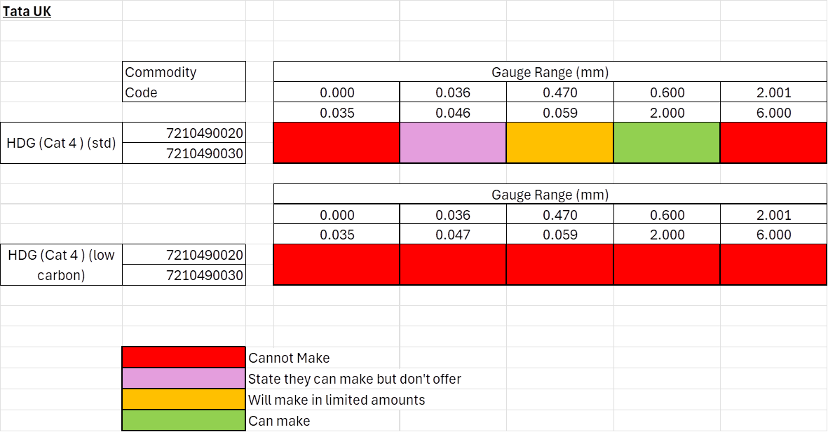
CAT 4 – TATA Capabilities HDG
Tata also cannot make HDG Galvanised product with a coating weight over 275mg or with a width above 1.83m.

Slide 5
CAT 4 – Other Steel Products
List of other essential products that TATA cannot make:
Materials the import codes are the same 7210490020 & 7210490030. Except for electro galvanised which is 72103000.
  Aluminised Material (all products)
  Electro Galvanised material (all products)
  Aluzinc material (all products)
  Galfan (all products)
  Galveanealled (all products)

Slide 6
Process Road Map
Next Steps Road Map
The DBT agrees with TATA and Down Stream Service Sector what TATA can and cannot make, see summary list above. It is very important that there is a discussion around 0.3mm – 0.7mm material, which they have the capability to make. 0.5mm is high a volume product is vital for construction.
The Commodity codes (HS8 categories) are then changed to highlight materials TATA cannot make. Materials they cannot make are then eliminated from the quota restrictions.
Country category caps need to be reviewed and agreed as 15% is not workable. Proposal 40%.
We need to agree how EU, ROW and Developing countries are to be included in the overall quota limits.
Once we have established the above parameters that we have to fit into, we can then discuss quota reductions, which broadly look possible but need to be sensible given market complexity.
We recommended that the actions above are carried out in joint meetings with DBT, TATA and the downstream Steel Service Sector. If possible or practical.
We need to maintain good communications throughout the process.

Slide 7


