Slide 1

Non-confidential
Meeting with THE uk officials concerning Transition review of anti-dumping duties on certain Ceramic Tiles originating in the People’s Republic of ChinA
(td0027)
CHINA Chamber of Commerce of Metals, Minerals & Chemicals Importers & Exporters
(CCCMC)

Slide 2

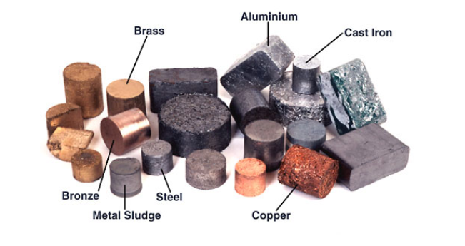
Non-confidential
Introduction to CCCMC
Nature of CCCMC:
Business Scope：
Nationwide
Industrial
Non-Profit
Social Organization
organizing members in responding to anti-dumping, anti-subsidy and safeguard investigations initiated by foreign countries

Slide 3
Non-confidential
CONTENT
Part I | Particular Nature of Measures & Transition Review
Part II | Substantive Comments on Injury & Threat Thereof
Part III | UK Economic Interest Test
Part IV | Comments on Product Scope
Part V | Conclusion & Request

Slide 4
Non-confidential
Part I
Particular Nature of Measures & Transition Review

Slide 5
Non-confidential
Part I
Particular Nature of Measures & Transition Review
Brief Review of Proceeding Histories
Nature of AD Measures Succession
Nature of the Transition Review

Slide 6
Non-confidential
Proceeding Histories
19 June
2010
Initiation of EU original investigation – AD560.
23 November 2017
Definitive Measures:
Individual rate – 13.9% ~ 36.5%
All other rate – 69.7%
31 January
2014
Initiation of EU’s 1st partial interim review – R586.
13 September
2016
Initiation of EU’s 1st expiry review – R650.
28 November – 30 March
2017 2018
DTI’s initiation of “Call for Evidence”.
Brexit (29 March 2019)
Transition Period
2 May
2019
Issuance of final findings of “Call for Evidence”.
31 December
2020
End of EU-UK Transition Period.
EU AD duty remained unchanged ever since, except for certain new exporters.
22 September
2022
Initiation of transition review – TD0027 by TRA.
Notes:
2017年11月28日 - 2018年3月30日
启动“Call for Evidence”确认是否要维持/终止措施。
2018年7月24日
公布初步审查结果，共审查118项原欧盟措施，终止76项，维持42项。
2018年7月24日 – 2018年8月24日（补充月）
补充“Call for Evidence”的征集
2019年5月2日
公布最终审查结果，共审查108项原欧盟措施。相较于2018年的初步审查，有11项措施在此期间到期。对于剩下的108项原欧盟措施，维持其中44项，终止63项。

Slide 7
Non-confidential
Part I
Particular Nature of Measures & Transition Review
Brief Review of Proceeding Histories
Nature of AD Measure Succession
Nature of the Transition Review

Slide 8
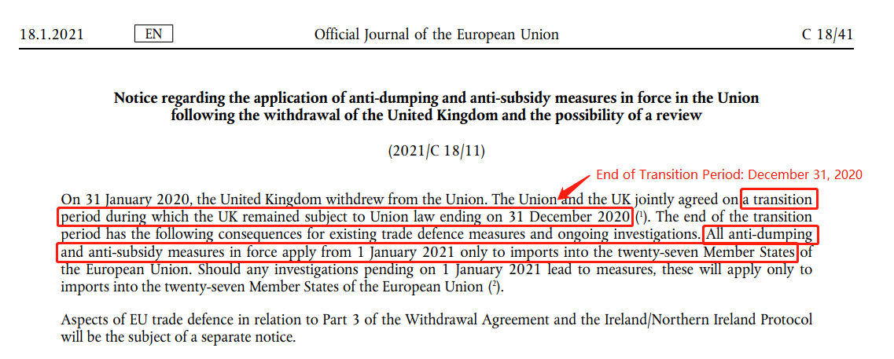
Non-confidential
Nature of AD Measure Succession
CCCMC doubts if the UK could be regarded as a legal successor to the EU under International agreements
The EU specifically set out in its Official Journal published on 18 January 2021, that the transition period which the UK remained subject to Union law ended on 31 December 2020.
All anti-dumping and anti-subsidy measures in force applied from 1 January 2021, only to imports into the twenty-seven Member States.
28 States excluding the UK
Source: EU Official Journal 2021/C 18/11

Slide 9
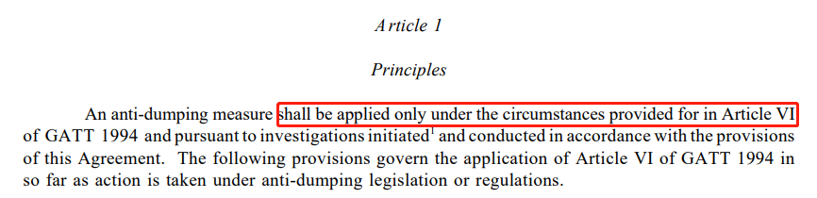
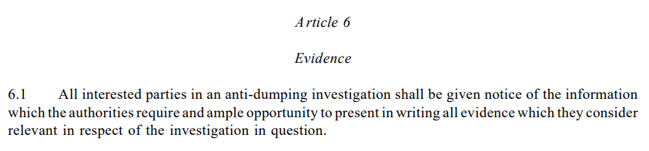
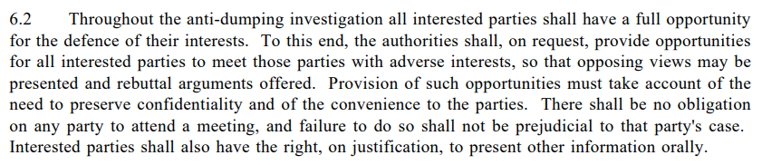
Non-confidential
Nature of AD Measure Succession
Article 1 & 6 of
WTO Anti-Dumping Agreement (WTO ADA)

Slide 10
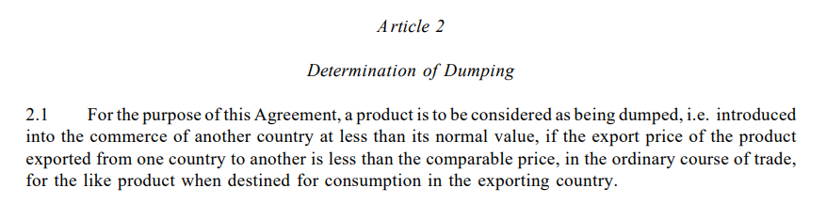
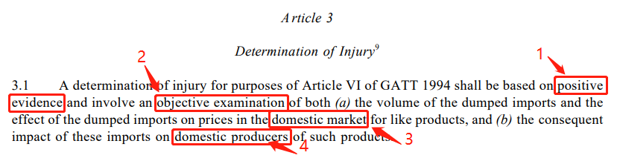
Non-confidential
Nature of AD Measure Succession
Article 2.1 & 3.1 of
WTO Anti-Dumping Agreement (WTO ADA)

Slide 11
Non-confidential
Nature of AD Measure Succession
Article 3.1 of
WTO ADA
Please see Part III.
Investigation conducted by EC; according to EU Basic AD Regulation;
Effect on the Union market.
Impact on the Union producers.
Current Transition Review
1 | Positive Evidence
2 | Objective examination
3 | Effect on domestic market
4 | Impact on domestic producers
28 Members

Slide 12
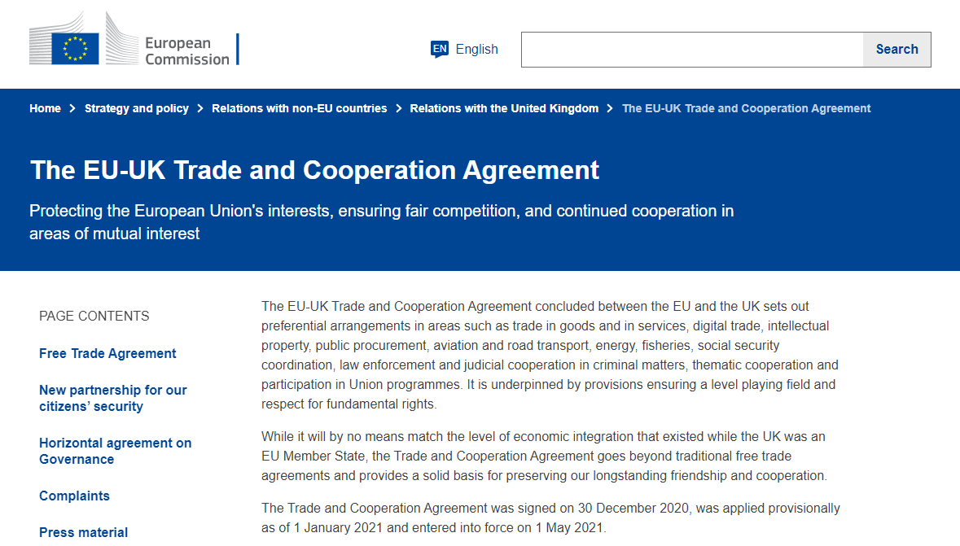
Non-confidential
Nature of AD Measure Succession
CCCMC doubts if the UK could be regarded as a legal successor to the EU under International agreements
The EU-UK Trade and Cooperation Agreement revealed that after Brexit, trade related aspects need to be settled by a mutually agreed agreement, instead of automatically applying measures the UK used to enforce when being a member of the EU.
Source: EU Document 22021A0430(01)

Slide 13
Non-confidential
Part I
Particular Nature of Measures & Transition Review
Brief Review of Proceeding Histories
Nature of AD Measure Succession
Nature of the Transition Review

Slide 14

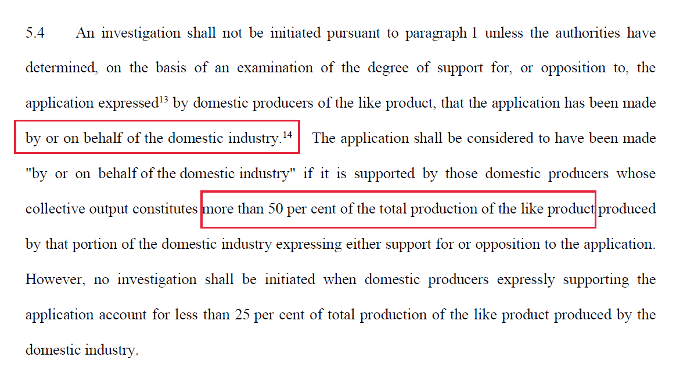
Non-confidential
Nature of Transition Review – Initiated upon application?
Article 5 of the WTO ADA
Revealing that the initiation of UK Transition Review is not representative of, or supported by, the domestic industry
Inconsistency with ART. 5.4
The reviewing authority (UK TRA) in the current transition review skipped the “representation” requirement and by a proprio motu initiation, thee “representation” requirement is omitted.

Slide 15
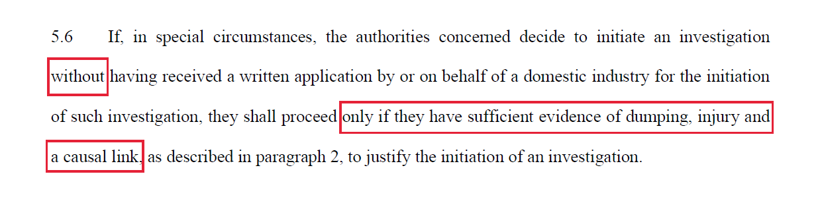
Non-confidential
Nature of Transition Review – Initiated proprio motu?
Article 5 of the WTO ADA
Revealing that the initiation of UK Transition Review proceeds without sufficing the required evidentiary threshold
Inconsistency with ART. 5.6
The reviewing authority (UK TRA) intends to proceed without sufficient or any prima facie evidence of dumping, injury and a casual link to justify the initiation of an investigation.
No relevant factual information regarding UK industry has thus far been disclosed by the authority.

Slide 16
Non-confidential
Part II
Substantive Comments on Injury & Threat Thereof

Slide 17
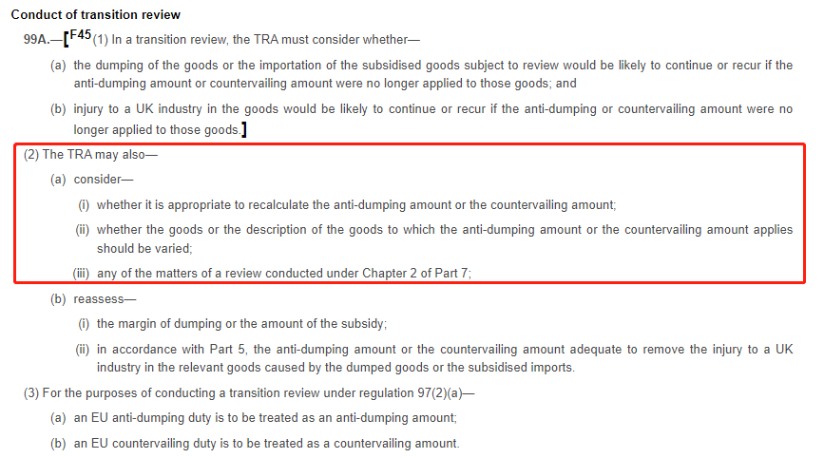
Non-confidential
Comments on Injury & Threat Thereof
Article 99A of the Trade Remedies (EU Exit) Regulations 2019

Slide 18
Non-confidential
Part II
Substantive Comments on Injury & Threat Thereof
Trend in the UK’s Imports of Chinese Products
Prospective Trend in Chinese Production

Slide 19
Non-confidential
Trend in Imports of Chinese Products
The UK’s Imports of Ceramic Tiles from China (M²)
AD Measures remained unchanged during this period, except for two new exporter reviews.
According to DTI’s final finding on 2 May 2019, EU measures on ceramic tiles were maintained to be subject to the current transition review to decide if changes are needed.
Source: Trade Map

Slide 20
Non-confidential
Trend in Imports of Chinese Products
The UK’s Imports of Ceramic Tiles from World (M²)
Source: Trade Map

Slide 21
Non-confidential
Trend in Imports of Chinese Products
The UK’s Imports from the World v. from China (M²)
UK’s Import in 2018-2022
UK’s Portion of Imports in 2022
Revealing: Lasting Nature
Source: Trade Map

Slide 22
Non-confidential
Trend in Imports of Chinese Products
The UK’s Import from Major Countries (2018-22)(MT)
Source: Trade Map

Slide 23
Non-confidential
Trend in Imports of Chinese Products
Import prices of Chinese product increased substantially in five years
Source: Trade Map

Slide 24
Non-confidential
Trend in Exports of Chinese Products Worldwide
China’s overall exports shown a clear downturn in 2018-22 (MT)
Source: Trade Map

Slide 25
Non-confidential
Trend in Exports of Chinese Products Worldwide
China’s overall export prices increased in 2018-22
Source: Trade Map

Slide 26
Non-confidential
Part II
Substantive Comments on Injury & Threat Thereof
Trend in the UK’s Imports of Chinese Products
Prospective Trend in Chinese Production

Slide 27
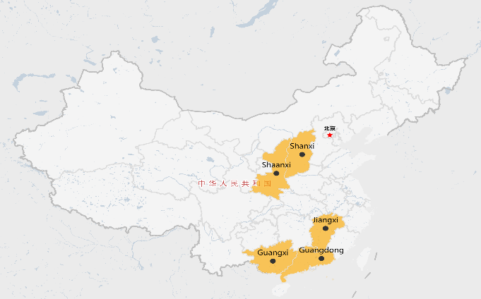
Non-confidential
Prospective Trend in Chinese Production
Prospective Reduction in Chinese Production
Stricter Energy Consumption Standards at National Level
Shutdown of Outdated Production Capacity Policy at Local Level
13 May 2021
Guidance Opinion about the Improvement of High Consumption & High Emission Control
Represent 46% Capacity of China in 2020
15 November 2021
High Emission Industry Energy Efficiency Standards and Benchmarks (2021 Version)

Slide 28
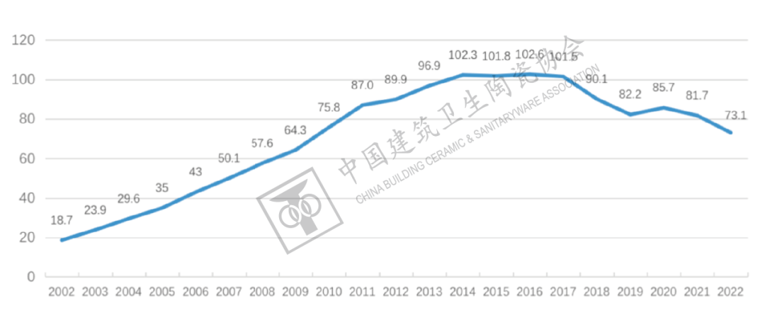
Non-confidential
Prospective Trend in Chinese Production
Reduction in Chinese Production of Ceramic Tiles (100 million M2)
Source: China Building Ceramic & Sanitaryware Association

Slide 29
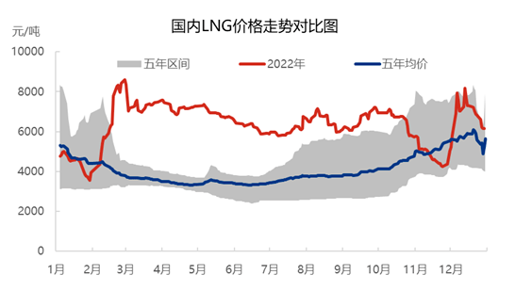
Non-confidential
Prospective Trend in Chinese Production
Rising LNG Price Pushed Up Cost of Production
RMB/Ton
LNG Price in China from 2018-2022
Range for the five years
Average for the five years
Month
Source: http://www.china-gases.com/article/item-4584.html

Slide 30
Non-confidential
Prospective Trend in Chinese Production
Mandatory Requirement on Change of Fuel from Coal to LNG
Causing a shrink of production capacity of 29%
47% left to be changed, may cause further reduction in production capacity

Slide 31
Non-confidential
Substantive Comments on Injury & Threat Thereof
Low percentage of Chinese products among other importing countries
Prospective reduction in Chinese imports
paired with
Measures levied solely upon Chinese products
would not be reasonable.
Restrictions on Chinese products are conducive to the rise of imports from other countries, and,
Competition between domestic and imported products would not be averted.

Slide 32
Non-confidential
Part III
UK Economic Interest Test

Slide 33
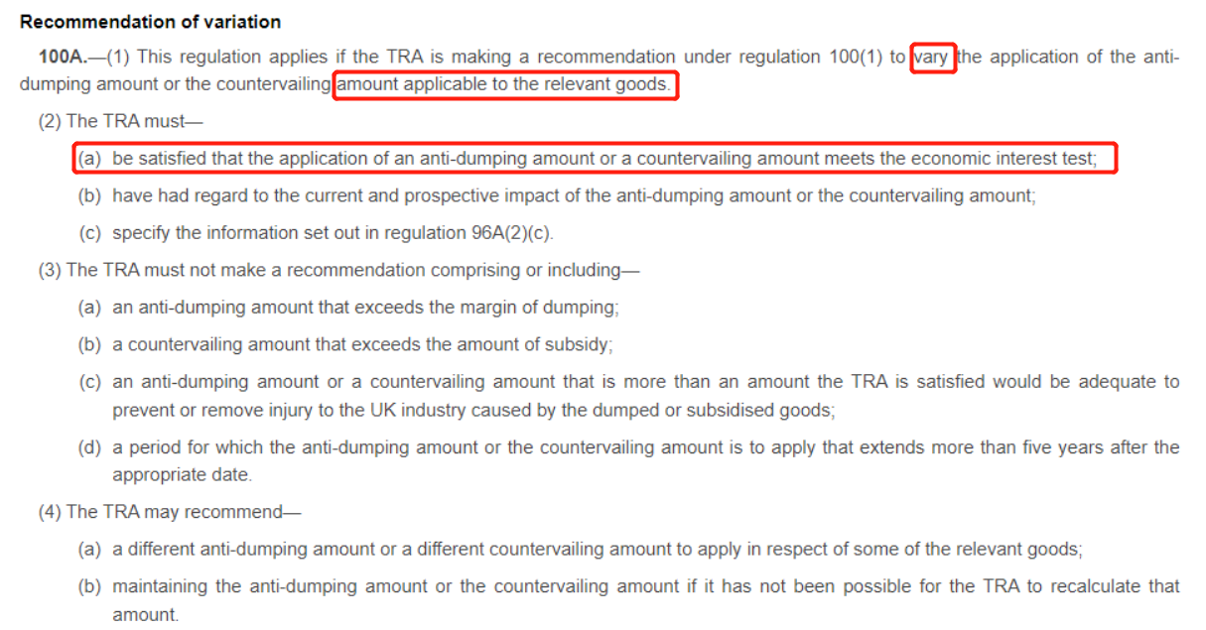
Non-confidential
UK Economic Interest Test
Article 100A(2)(a) of the Trade Remedies (EU Exit) Regulations 2019

Slide 34
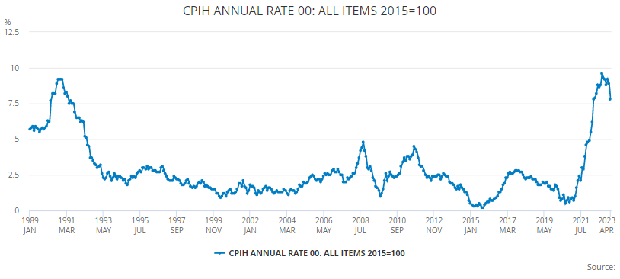
Non-confidential
UK Economic Interest Test
The UK’s consumer prices index (CPI) shows a historically high level of inflation rate over the past 35 years
Source: UK Office for National Statistics
Notes:
https://www.ons.gov.uk/economy/inflationandpriceindices/timeseries/l55o/mm23

Slide 35
Non-confidential
Part IV
Comments on Product Scope

Slide 36

Non-confidential
Comments on Product Scope
Exclusion of Certain Products from the Product Scope
Reasons for Exclusion:
The UK industry is not able to produce Porcelain tiles;
Porcelain tiles cannot be substituted by other types of tiles that the UK industry currently produces, thus having no like products；
Also request to exclude: mosaic, ceramic slabs, non-glazed polished tiles, and other types which is not produced or although produced but not meet the market demand.
Non-substitutability
Strength | PT can stand heavy duty, being unbreakable and wear resistant.
Frost Resistance | PT are resistant to freezing and thawing, and thus can be used for outdoor tiles that won’t freeze and break during winter.
Cost Efficiency | PT can substitute a lot of existing types of tiles (but may cause much higher cost), while other existing types in the UK cannot substitute PT.
Product Type: Porcelain Tiles (with water absorption < 0.5%) – “PT”
Source: UK Office for National Statistics
Notes:
https://www.ons.gov.uk/economy/inflationandpriceindices/timeseries/l55o/mm23

Slide 37



Non-confidential
Comments on Product Scope
Exclusion of Certain Products from the Product Scope
Also request to exclude: mosaic, ceramic slabs, non-glazed polished tiles, and other types which is not produced or although produced but not meet the market demand.
Source: UK Office for National Statistics
Notes:
https://www.ons.gov.uk/economy/inflationandpriceindices/timeseries/l55o/mm23

Slide 38





Non-confidential
Comments on Product Scope
Complementarity of Chinese Imports
Chinese imports would complement UK production in certain types of ceramic tiles that satisfies the diversity of market demand, and eventually benefits UK consumers.
Source: https://www.investing.com/economic-calendar/cpi-68
Notes:
https://www.ons.gov.uk/economy/inflationandpriceindices/timeseries/l55o/mm23

Slide 39
Non-confidential
Part V
Conclusion & Requests

Slide 40
Non-confidential
Conclusion & Request
Conclusion & Request
Summary of Arguments:
The current AD measures and transition reviews remain doubtful on legality.
Despite the existing measures on Chinese ceramic tiles, the decrease of Chinese imports to the UK and the prospective reduction in production in China indicated that termination of the current measures unlikely leads to the recurrence of dumping.
Continuing the measures would not be in the UK’s broader economic interests.
Conclusion & Request:
To restore legality and redress the situation, the current AD measures imposed by the EU should be abandoned or replaced with a fact-based investigation made by TRA.
The termination of the current review is warranted also because of the economic interest of the UK.

Slide 41
Non-confidential
Thank You!

